Slide 1
OpenGL L1: Setup
Xin Zheng
11760004@mail.sustech.edu.cn
1001, Ipark A7

Slide 2
What is OpenGL?
Solve the problem of data starvation
OpenGL is a graphic API rather than a platform, more specifically a group

Slide 3






Application: graphic rendering
3D coordinates → 2D coordinates in the window→ colored pixels
Vertex shader
Shape assembly
Geometry shader
Fragment shader
rasterization
Blending
Vertex data
→
→
→
→
→
→

Slide 4
Create a window
Create an OpenGL environment and application window
Some popular libraries: GLUT, GLAD, GLEW, GLFW…

Slide 5
Example: GLUT
OpenGL Utility Toolkit
Create a cross-platform toolkit
Simplify conditions for learning openGL

Slide 6
Configure GLUT
Download from the official website
Build in VS (on Windows), or gcc (on Linux)
glut.lib, glut32.lib …lib\x86
glut.dll, glut32.dll C:\Windows\System32 or C:\Windows\SysWOW64
glut.h …include\gl

Slide 7
Create a new project
Create a new project in VS
Link the libraries to the project
Project->properties->linker->input->include…

Slide 8
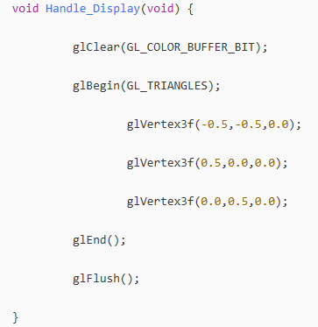
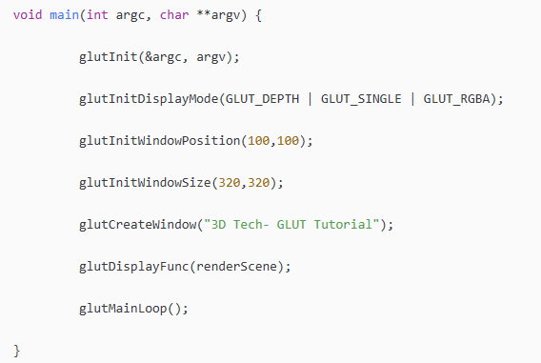
Code

Slide 9
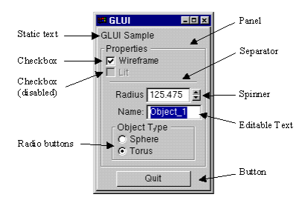
GLUI
GLUI is a GLUT-based C++ user interface library
GLUI provides controls such as buttons, checkboxes, radio buttons, and spinners to OpenGL applications

Slide 10
Compile GLUI
glui-2.36/src/msvc/glui.sln
Batch generation in VS
Configure file path

Slide 11
Assignments
Create a window whose title is your name and student #
Change the window’s background color
Screenshot result with your pc background wallpaper

